Slide 1


PAO-BU-LIAO
A Smart Contract-based Management System for
Advance Receipts and Accounts Receivable.
18th April, 2025
Group Members: Kai Ren, YiMing Jiang, WeiJie Zhang, Rui Hu, Yang Lan

Slide 2

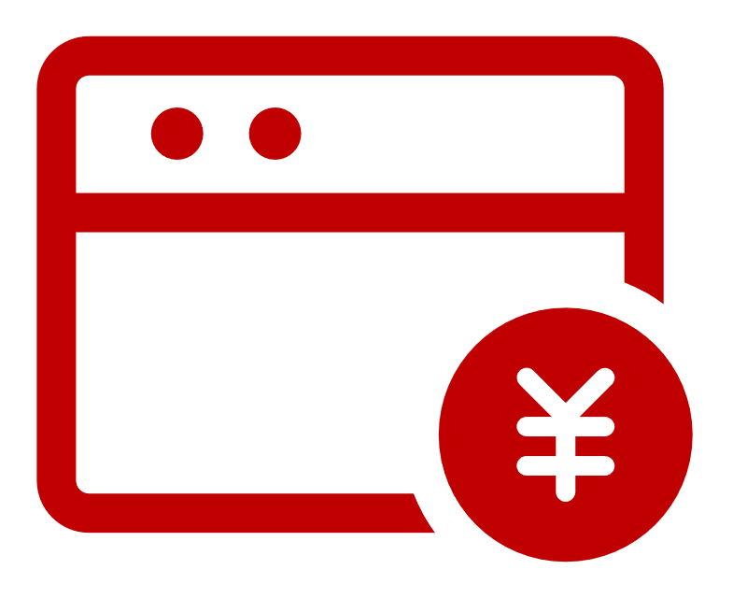





I. Introduction: Motivation
Pay First, Use Later: Advance Receipts
Use First, Pay Later: Accounts Receivable
Cash First
Welfare
Willingness
Service First
Buyer
Recharge Cash
Seller
Buyer
Try Service
Seller
Service Later
Cash Later
Seller Promise: Feel free to recharge, I won't run away!
Buyer Promise: Try a few more times, I won't run away!
Based on the TRUST between the Buyer and Seller. It’s NOT sturdy!
Seller True Thought:
Feel free to recharge, I'll run if I can't serve you!
Buyer True Thought:
Try a few more times, I will run and spend nothing.
Have you ever experienced a seller RUNNING out of business after charging a card?
Gym, Barbershop, Coffee Shop …
It had happened in the Coffee Shop of STL! 100 students, nearly 10,000 RMB, 1 Year!

Slide 3


I. Introduction: Motivation
Fig 1.2 Statistics on Prepaid GYM Run Away.
Fig 1.3 Statistics on Prepaid Coffee & Milk Tea Shop Run Away.
Runaways Happen All the Time!
The recovery rate of arrears averaged less than 20 percent.
It appears to be poor cash flow management.
The essence is that Money is Untraceable and can be used in any way.
Pooling out of control
“unregulated misappropriation” of advances
Legal and regulatory loopholes
low cost of violating the law
Business strategy: maliciously designed “harvest traps”
Is there a way to accurately TRACK Services and Cash Flow so that it PAO-BU-LIAO? Smart Contract!
Data Source: China Consumers' Association, Referee Websites

Slide 4
I. Introduction: Framework
2. Bussiness Architecture
1. Verification
2. Establishment
3. Consumption
4. Termination
3. Technological Implementation
Why we must use Smart Contract to solve this challenge ?
1. Tamper-proof Automated Execution
2. Transparent Regulation of Cash
3. Conditional Trigger Payment
4. On-chain Deposit and Traceability
4. Conclusion & Extension
Paobuliao is Redefining Trust in Transactions

Slide 5


Business Architecture
Pay First, Use Later
Use First, Pay Later
Contract Establishment
Daily Consumption
Contract Termination

Slide 6

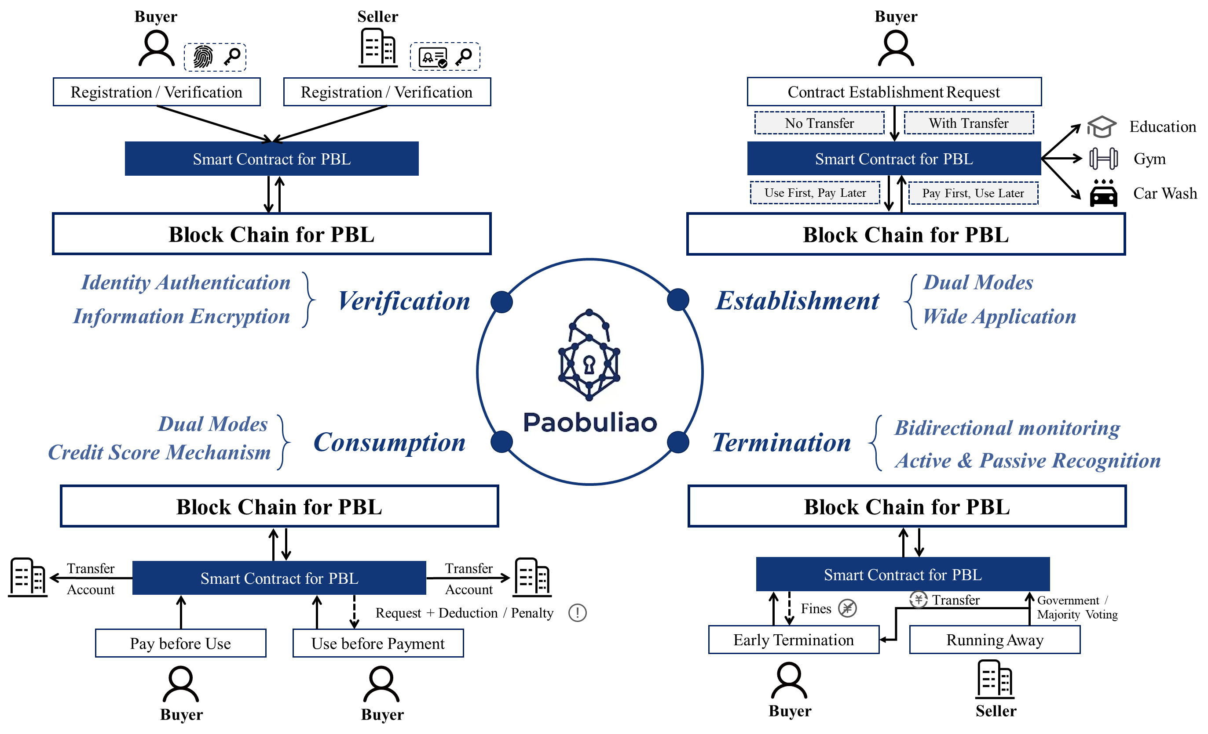
Ⅱ. Business Architecture
PaoBuLiao (PBL)
Your Online Transaction Solution.
01
2 Modes
Pay First, Use Later & Use First, Pay Later
02
4 Scenarios
Verification, Establishment,
Consumption, Termination
03
Security Guarantee
System Based on SC,
NO Losses Will Occur
System Details >>>
6

Slide 7








Ⅱ. Business Architecture Analysis: Registration / Verification
Bioinformatics / Business Qualification Certification
PK Encryption and SK Authentication
Buyer Registration / Verification
Seller Registration / Verification
Buyer
Seller
Biological Information
Business Qualification
Encrypted Biological Information
Encrypted Business Qualification
Registration / Verification
Registration / Verification
Smart Contract for PBL
Smart Contract for PBL

Slide 8




Ⅱ. Business Architecture Analysis: Contract Establishment
Dual Modes: Use First, Pay Later & Pay First, Use Later
Credit Scoring Mechanism (Permission)
Contract Establishment
(Pay First, Use Later)
Contract Establishment
(Use First, Pay Later)
Buyer
Buyer
After Verification …
After Verification …
Contract Establishment Request
Contract Establishment Request
Transfer Money to Smart Contract
Credit Evaluation
Smart Contract for PBL
Smart Contract for PBL

Slide 9






Ⅱ. Business Architecture Analysis: Daily Consumption (1/2)
Data Updated after Service Provided
Money Gradually Transferred from Buyer to Seller
Daily Consumption (Pay First & Use Later)
Scan the code before enjoying the service, with record sent to the SC
Buyer
After Verification …
Enjoy Service
Deduct Money from Buyer
Upload Service Usage Record
Transfer Money to Seller
Smart Contract for PBL

Slide 10



Ⅱ. Business Architecture Analysis: Daily Consumption (2/2)
Multiple options: Per-Use Card / Monthly / Annual Pass
Credit Scoring Mechanism (More Discount)
Daily Consumption (Use First & Pay Later)
Buyer
Deduct Credit Scores / Lawsuit
After Verification …
Insufficient Account Balance
Enjoy Service
Failed
Initiate Fine Deduction Request
Upload Service Usage Record
Successfully
Deduct Money from Buyer
Smart Contract for PBL
Periodically
Transfer Money to Seller

Slide 11


Ⅱ. Business Architecture Analysis: Contract Termination (1/4)
Bidirectional monitoring: Buyer Side
Reclaim Discount and Give It Back
Buyer Terminates the Contract (Pay First & Use Later)
Buyer
After Verification …
Contract Termination Request
Impose Fines on Buyer
Smart Contract for PBL
Return Discount to Seller
Transfer Money Left to Buyer

Slide 12
Ⅱ. Business Architecture Analysis: Contract Termination (2/4)
Bidirectional monitoring: Buyer Side
Reclaim Discount and Give It Back
Buyer Terminates the Contract (Use First & Pay Later)
Buyer
Deduct Credit Scores / Lawsuit
After Verification …
Insufficient Account Balance
Contract Termination Request
Failed
Initiate Fine Deduction Request
Smart Contract for PBL
Successfully
Deduct Money from Buyer
Return Discount to Seller

Slide 13





Ⅱ. Business Architecture Analysis: Contract Termination (3/4)
Bidirectional monitoring: Seller Side
Active Recognition & Passive Recognition
Seller Breaches the Contract and Runs Away (Pay First & Use Later)
Buyers
Government
After Verification …
Buyers Report
Majority Voting
Verify Qualifications
Automatic Contract Termination
Smart Contract for PBL
Transfer Money Left to Buyer

Slide 14
Ⅱ. Business Architecture Analysis: Contract Termination (4/4)
Bidirectional monitoring: Seller Side
Active Recognition & Passive Recognition
Seller Breaches the Contract and Runs Away (Use First & Pay Later)
Buyers
Government
After Verification …
Buyers Report
Majority Voting
Verify Qualifications
Smart Contract for PBL
Automatic Contract Termination

Slide 15
Ⅱ. Business Architecture
PaoBuLiao (PBL)
Your Online Transaction Solution.
01
2 Modes
Pay First, Use Later & Use First, Pay Later
02
4 Scenarios
Verification, Establishment,
Consumption, Termination
03
Security Guarantee
System Based on SC,
NO Losses Will Occur
System Details >>>
15

Slide 16
Technological
Implementation

Slide 17
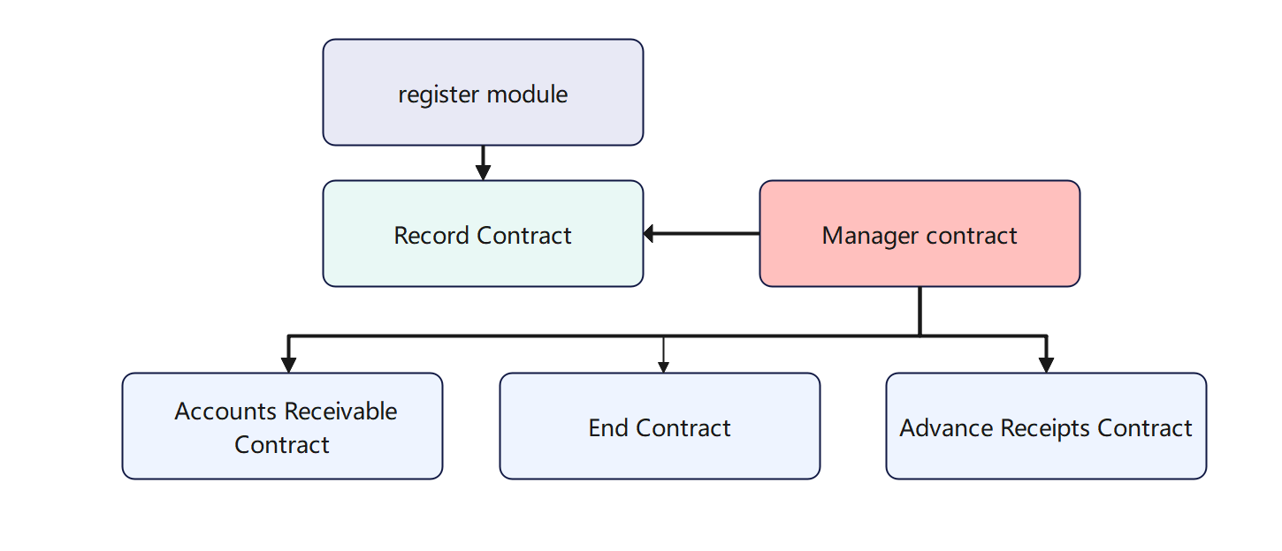

Ⅲ. Underlying Technical Logic
Login module (Login Module):
Responsible for user registration and writing to the Record Contract.
Record Contract (Record Contract):
Stores all user information, functioning like a database.
Manager Contract (Management Contract): Addresses misconduct and enforces penalties.
Accounts Receivable Contract (Pay-After-Use Contract):
Handles the logic of "use first, pay later."
Advance Receipts Contract (Pay-Before-Use Contract):
Manages the logic of "pay first, use later."
End Contract (Termination Contract):
Determines/terminates either the Pay-After-Use or Pay-Before-Use Contract.

Slide 18

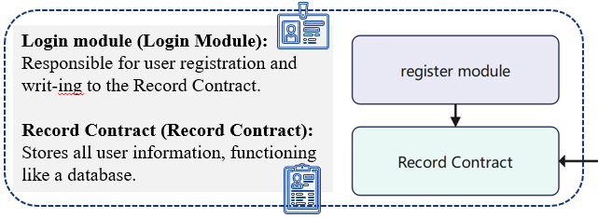
Ⅲ. Underlying Technical Logic: Identity Authentication/Registration
Identity Authentication
Establishment from Two Perspectives: Buyer Onboarding and Seller Onboarding
Buyers
Sellers
During registration, Buyers complete identity authentication and registration by providing biometric information (such as fingerprints, facial recognition, etc.) or generating a cryptographic key pair.
The smart contract stores the following information:
Sellers must provide qualification documents for registration and generate a key pair to ensure the credibility of the service provider's identity.
The smart contract stores the following information:
User ID
Encrypted identity hash
buyerPubKey
Merchant ID
Encrypted qualification hash
sellerPubKey
Contract
The Record contract stores all user/merchant information.
The contract defines two structs, BuyerInfo and SellerInfo, which are used to record the identity and transaction information of users and merchants, respectively. These structs support subsequent
payment and service logic invocations.
struct Buyerlnfo {
uint256 id;
bytes publicKey;
string name;
uint256 balance;
…
}
struct Sellerlnfo {
uint256 id;
bytes publicKey;
string name;
uint256 balance;
boolean status;
…
}

Slide 19

Ⅲ. Underlying Technical Logic: Payment Logic
Pay-After-Use Contract
consume(userId, amount)
Add amount to user's pendingDebt
payDebt(userId, amount)
Ensure user exists
Require amount <= pendingDebt
Deduct amount from pendingDebt
Add amount to sellerBalance
Pay-Before-Use Contract
deposit(userId, amount)
Deduct amount from user‘s balance
Add amount to buyer's balance
freeze balance
consume(userId, amount)
Ensure user exists
Require sufficient balance
Add amount to sellers
Pay-After-Use Contract
Pay-Before-Use Contract
Econsume
Paydebt
Functions include: Credit score adjustment for users
Deposit
Consume
Functions include: Credit score adjustment for users
Pay-After-Use Functionality
buyers can access services immediately
The contract records the user's "pending debt", which must be settled later via payDebt()
Pay-Before-Use Functionality
buyers must deposit funds first (prepaid amount locked in the smart contract)
Direct transfer to merchants upon consumption
Payment Logic

Slide 20
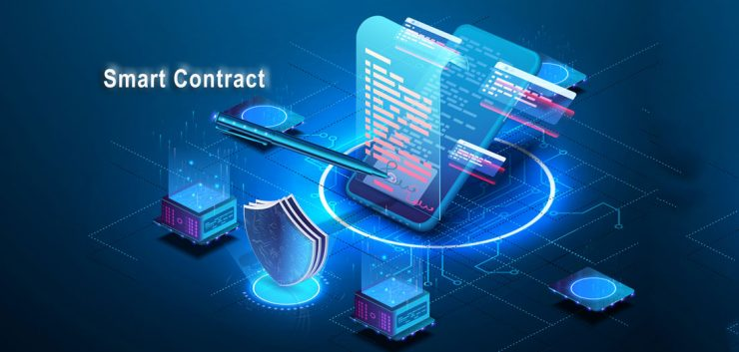
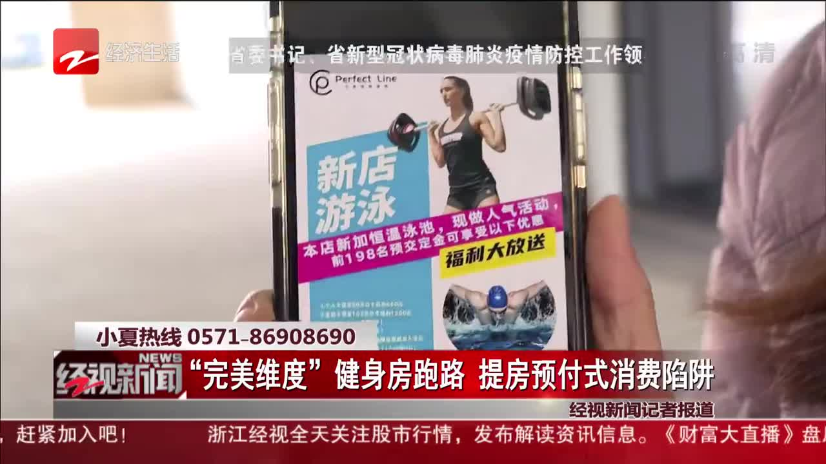
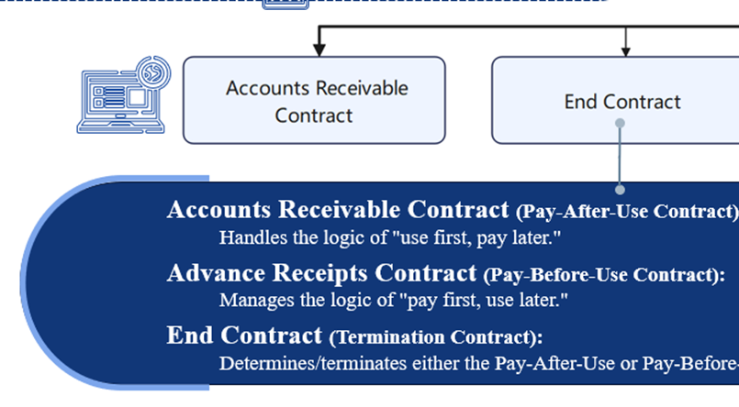
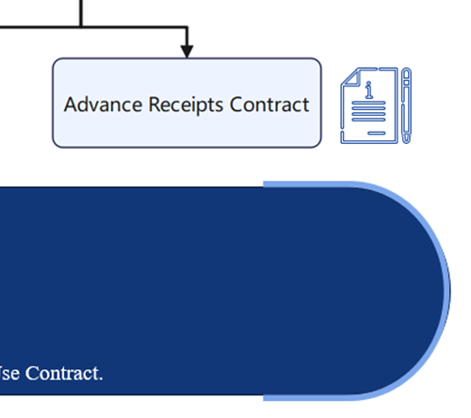
Ⅲ. Underlying Technical Logic: Credit Score & Termination Mechanism
Low Credit Score Consequences:
Service Suspension
The user/merchant's account privileges will be temporarily frozen
Platform Intervention
Automatic Arbitration
May involve third-party arbitrators for dispute resolution
Termination Mechanism
Credit Score
In both the Pay-After-Use and Pay-Before-Use contracts, we maintain credit scores (Credit Score) for both buyers and sellers.
For Buyers:
Must ensure their balance exceeds the pending debt (pendingDebt) by the repayment due date.
Late payments or defaults will result in credit score deductions.
For Sellers:
Receiving negative ratings will lead to credit score reductions.
User Contract Termination
Voluntary termination
Contract expiration
Seller
If a seller abandons operations ("runs away") or receives complaints exceeding 60%, the system will immediately invoke the Manager Contract, which will execute penalty mechanisms according to predefined rules.
Buyer
When voluntarily terminating a contract, users shall incur penalties if stipulated in the contract terms. The system will automatically invoke the Manager Contract, which will execute penalty mechanisms according to predefined rules.
Merchant Violations
Complaint rate ≥60%
Business abandonment ("Runaway")

Slide 21
Ⅲ. Underlying Technical Logic: Manager contract
Chinese pseudocode
checkStatus(userIds, sellerIds):
对每个 userId:
如果 用户信用分 < creditThreshold:
标记为黑名单用户
对每个 sellerId:
如果 商家信用分 < creditThreshold:
标记商家为非活跃
如果 资质已过期:
注销商家
如果 资质30天内过期:
触发资质即将过期提醒事件
Active Check Mechanism
(checkStatus() Scheduled Call)
Verify if user/merchant credit scores fall below threshold → Execute penalties
Monitor merchant certification expiration → Trigger alerts or deactivation
checkStatus(userIds, sellerIds):
for userId in userIds:
if user.creditScore < CREDIT_THRESHOLD:
flag_as_blacklisted(userId)
for sellerId in sellerIds:
if merchant.creditScore < CREDIT_THRESHOLD:
mark_as_inactive(sellerId)
if certification.is_expired():
revoke_license(sellerId)
if certification.expires_in(30 days):
trigger_alert("Certification Expiring Soon", sellerId)
Chinese pseudocode
Passive Trigger Mechanism
(Event-Driven)
Handle Merchant Abandonment:Mark merchants as inactive upon predefined triggers
Resolve Excessive Complaints:Process user complaint thresholds
reportSellerInactive(sellerId):
标记商家为非活跃
触发“商家跑路”事件
reportComplaint(sellerId):
商家投诉数 +1
如果 投诉数 ≥ maxComplaints:
标记商家为非活跃
触发“商家停用”事件
reportSellerInactive(sellerId):
mark_as_inactive(sellerId)
emit_event("Merchant Abandonment", sellerId)
reportComplaint(sellerId)
merchant.complaint_count += 1
if merchant.complaint_count >= MAX_COMPLAINTS:
mark_as_inactive(sellerId)
emit_event("Merchant Suspension", sellerId)

Slide 22
Conclusion & Extension

Slide 23

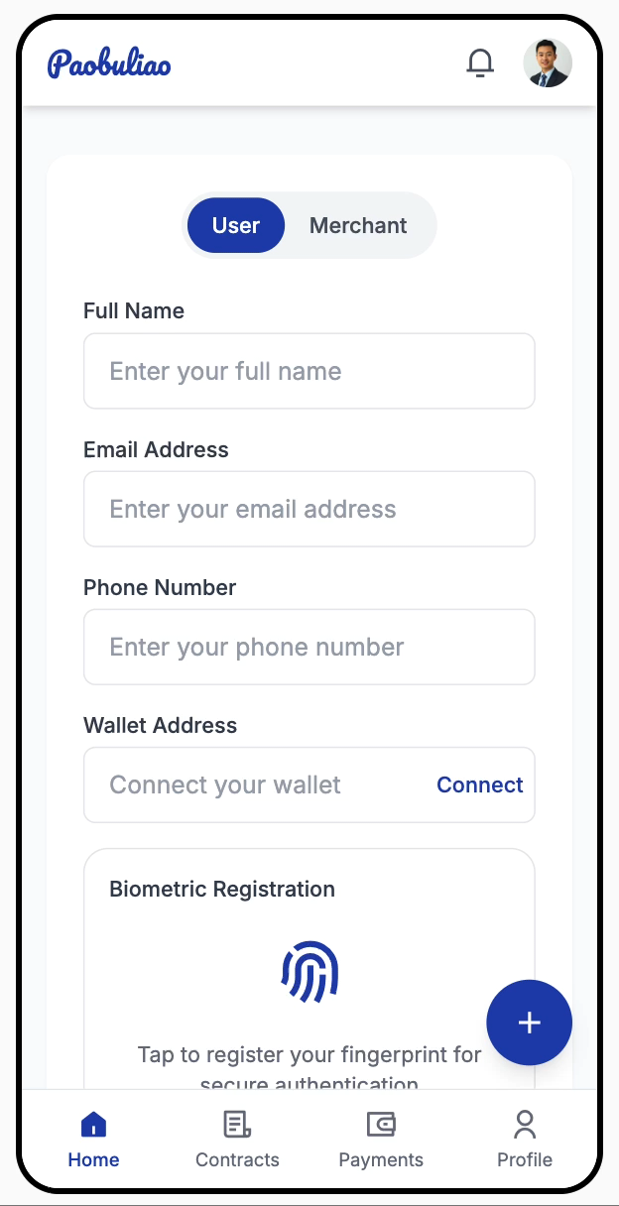
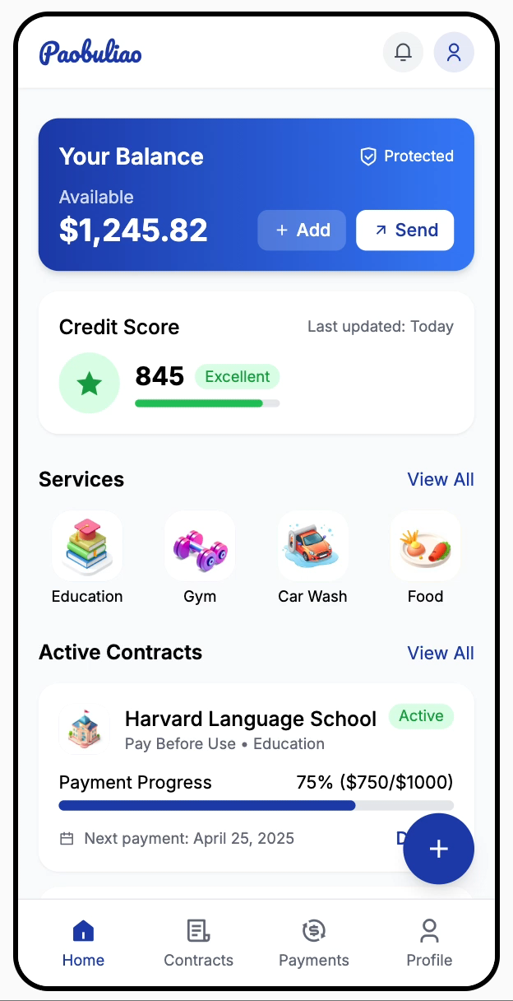
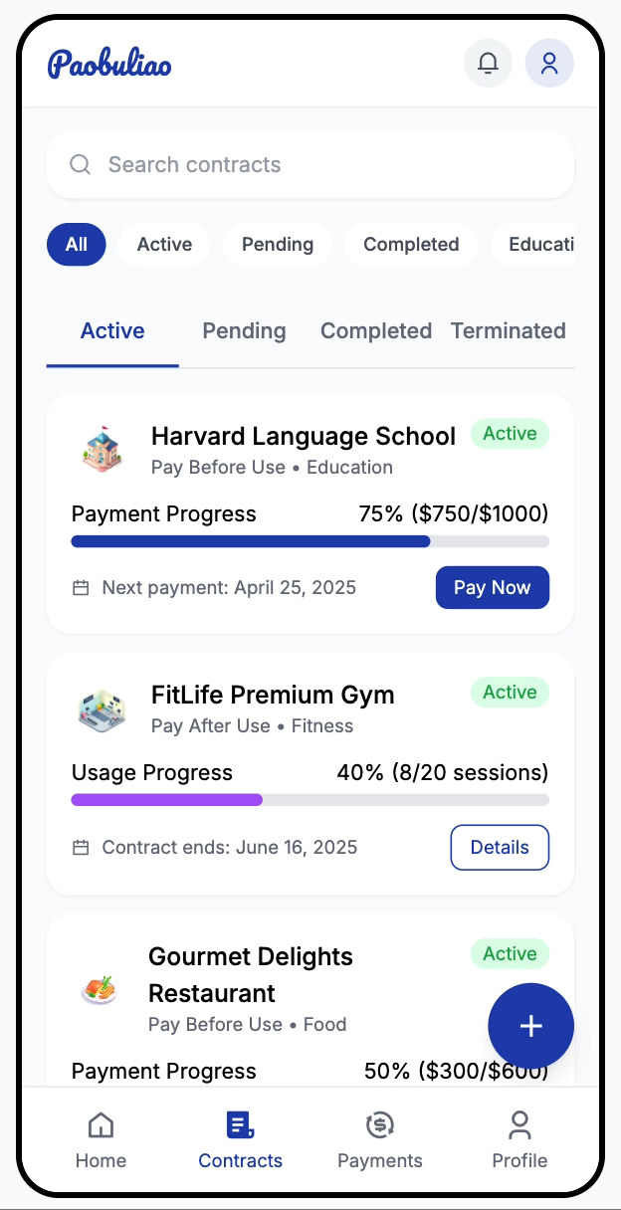
Paobuliao
- Train Better, Pay Safer -
IV. Function Demo
Registration
Home page
Contract

Slide 24


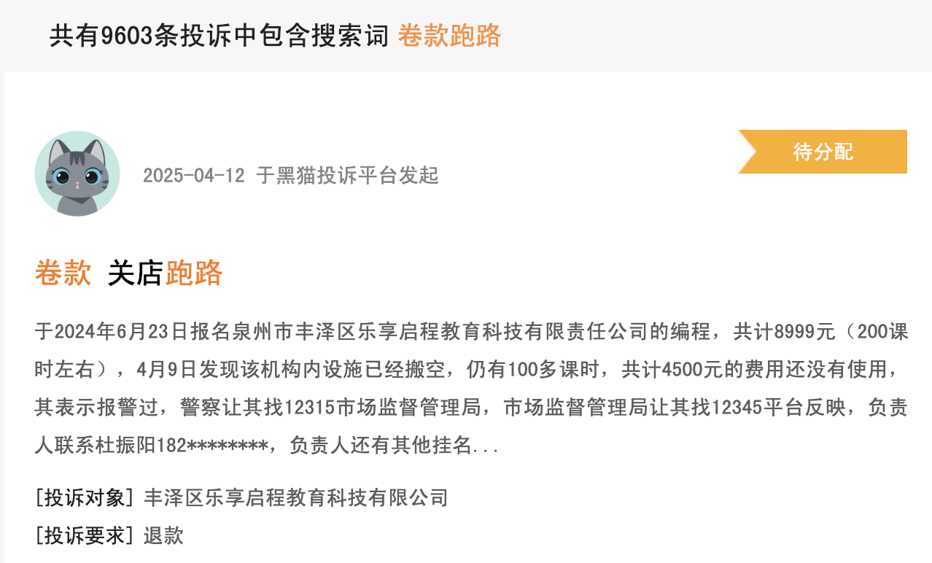
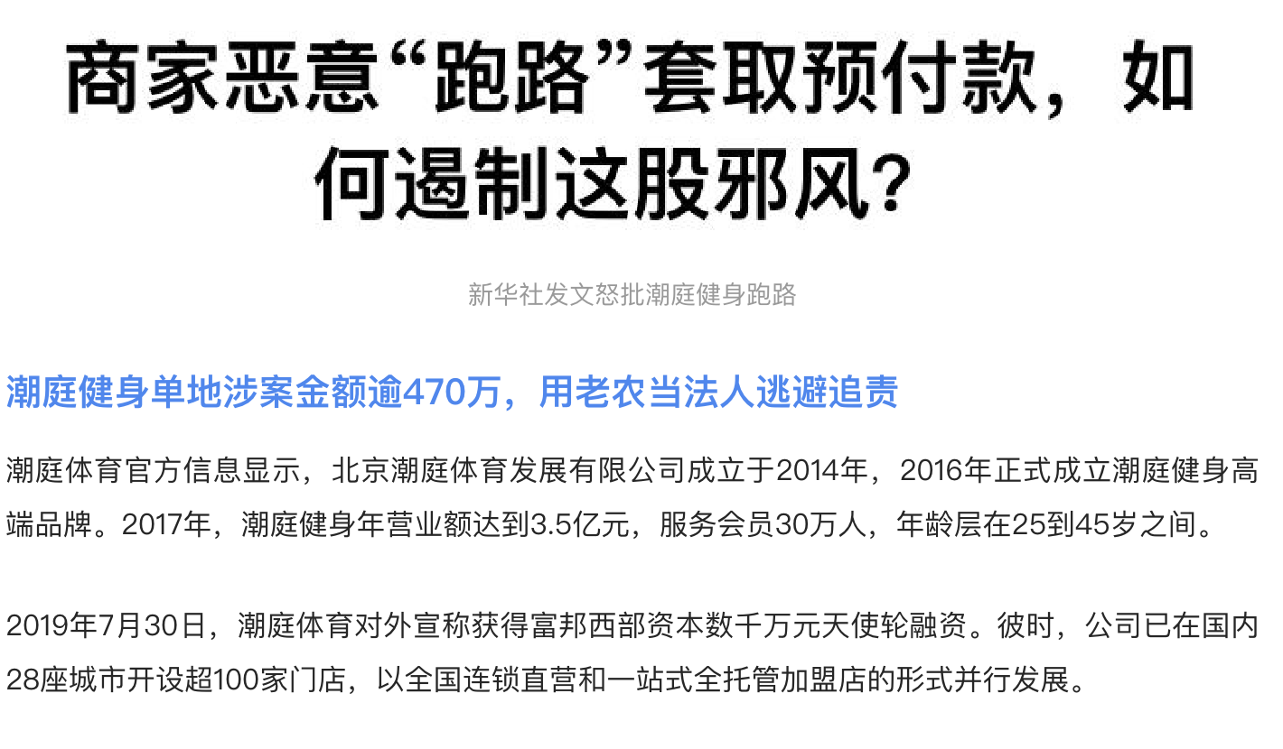
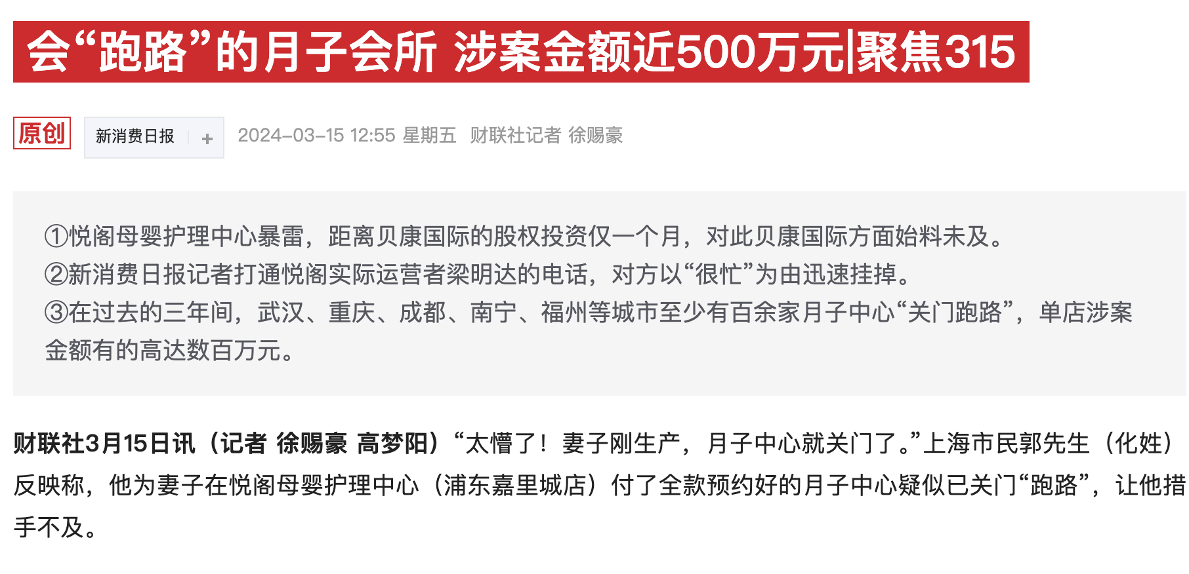
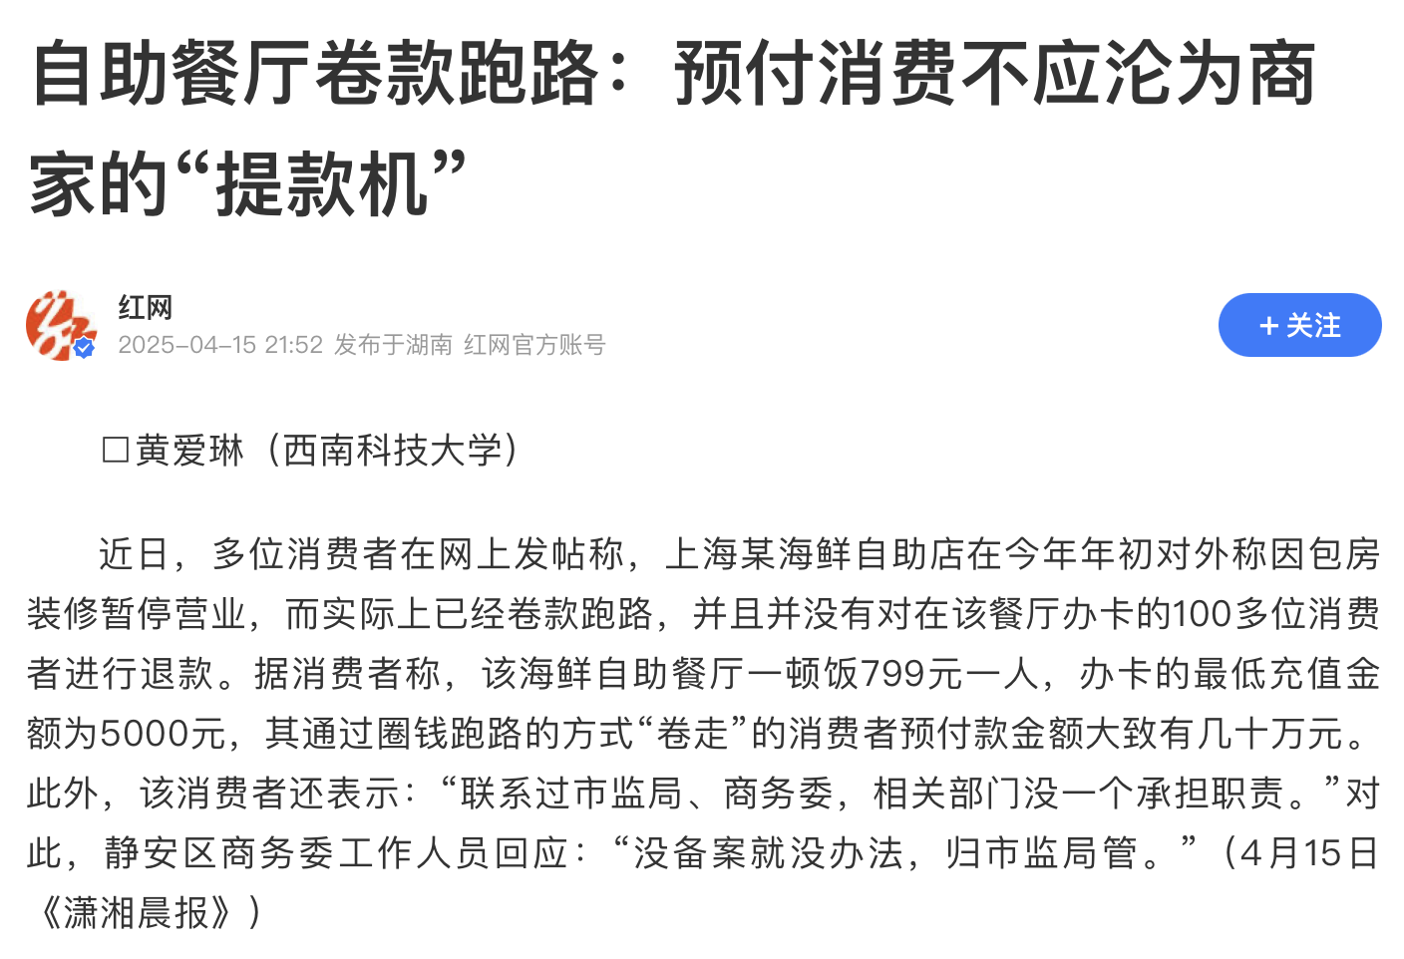
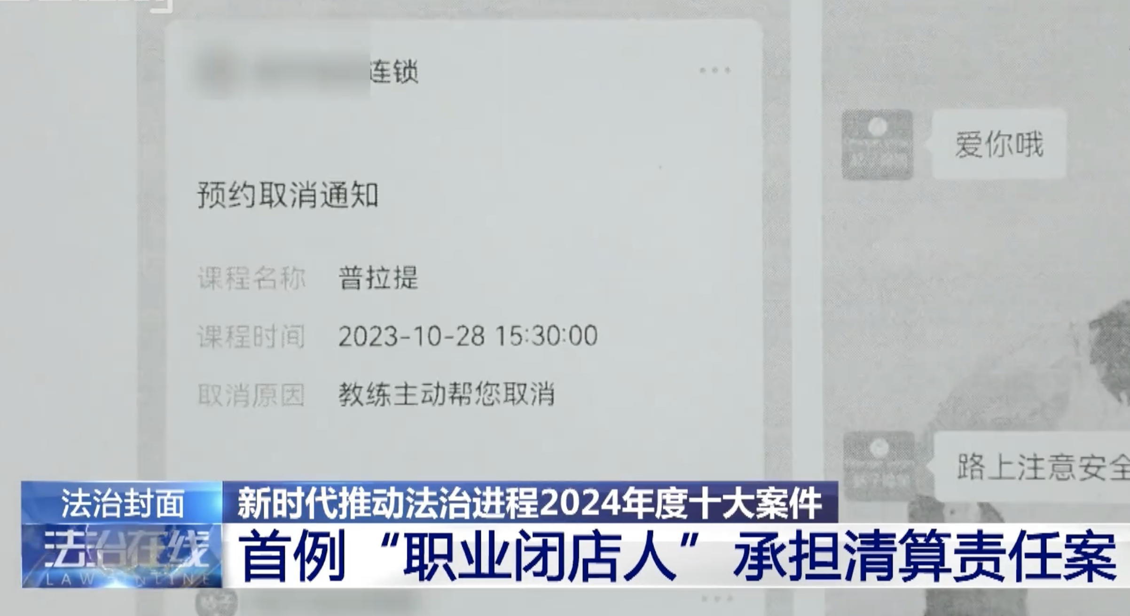
IV. Prepaid Chaos is Everywhere — Trust is Broken
The Number of Prepaid Complaint Issues in Chaoyang
From Users' Perspective | From Merchants' Perspective
✘ Prepaid gyms shut down overnight — money gone | ✘ Users default on payments after using the service
✘ Education providers go bankrupt — no refund | ✘ Merchants cover upfront costs but can’t recover losses
✘ Lack of effective legal protection | ✘ Long, costly dispute resolution process
69734
64932
25379
18294
8372
2020
2021
2022
2023
2024
The Collapse of Prepaid Trust:
3-Fold Increase in Consumer Complaints
Data Source: Chaoyang Distrct Procuratorate

Slide 25







IV. Redefining Trust in Transactions
Key Technologies
Secure Identity via Biometrics
+
Asymmetric Encryption
Dual Contract Modes
–
Pay Before / Pay After
On-chain Reputation
&
Penalty System
Use First, Pay Later
Pay First, Use Later
Fines
Government /
Majority Voting
Prevents Identity Fraud
Flexible For Users & Services
Transparent Rules & Risk control
Complies With KYC/AML Regulations
Covers Diverse Industries
Automated Enforcement
User-defined Trust-based Entry
Real Accountability
Secure Key Management
Smart-contract Based
Smart-contract Governs
No Fake User Sign-ups
No Platform Bias Toward A Single Flow
No Delayed or Biased Penalty Decision
Registration / Verification
Consumption / Establishment
Termination

Slide 26









IV. Purpose & Impact · Who Benefits?
Customer Confidence
Peace of mind
Financial Risk
Long-term Trust
Lower trial barriers
Brand Reputation
Merchants
User
Repeat Customers
Better service terms
This Isn’t Just an App
“It’s a New Way to reBuild Trust”
Society
Fair Market
Local Service
Legal Cost

Slide 27
THANK YOU
18th April, 2025
Group Members: Kai Ren, YiMing Jiang, WeiJie Zhang, Rui Hu, Yang Lan

